Slide 1
Chada Tech
By Arren Parker

Slide 2
Scrum-agile Team
Product owner
Scrum Master
3-5 Developers

Slide 3
Product Owner
The product owner is responsible for defining the direction of the project. They have a clear understanding of what the business and users need from the product being developed, and they translate these needs to the Scrum team.
Product owners make sure that the product being developed delivers maximum value for the business and users.

Slide 4
Scrum Maser
The Scrum Master ensures that the team follows Agile best practices and is in charge of addressing and removing any productivity blockers that may come up. Essentially, the Scrum Master is the authority of the Agile and Scrum

Slide 5
Development Team
The development team is a group of people with the skills needed to build the product as envisioned by the product owner. The team doesn’t always include just developers – architects, writers, designers and other specialized roles are also considered part of the development team.

Slide 6
The Agile Software Development Life Cycle
The Agile software development life cycle is the structured series of stages that a product goes through as it moves from its beginning to end. It contains six phases: Concept, Inception, Iteration, Release, Maintenance, and Retirement.

Slide 7
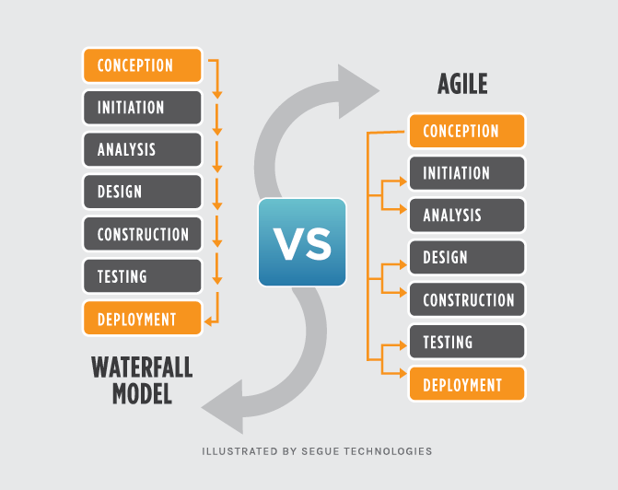
Agile vs Waterfall

Slide 8
The difference…
Waterfall approach breaks down software development into isolated phases that flow into each other – meaning cant work forward or go back…
Agile advocates interactive development cycles in which multiple lifecycles phases can run in parallel – allowing developers to make changes to the first phase while in the last.

Slide 9
Waterfall Approach
I think the waterfall approach would be a better approach for a more time crunching project, more of a last minute need to get done project. This can be good for some as they may work better under pressure to ensure correctness without the ability to go back phases and make changes

Slide 10
Agile Approach
I would use the agile approach as often as I could. For the simple fact that if a big change was made, you have the ability to make those changes. Another thing I like is the amount of communication throughout the project. You should never be left unknowing and this approach should always keep the team up to date throughout the entire project.

Slide 11
Sources Cited
www.theserverside.com Agile vs Waterfall: What’s the difference? By: Darcy Declute. Published 15 Sep 2022
www.businessnewsdaily.com What is Agile Scrum Methodology? By: Sean Peak. Published 21 Feb 2023
www.Atlassian.com What is Scrum? By: Claire Drumond

